Slide 1

ivane javaxiSvilis saxelobis Tbilisis saxelmwifo universiteti
zust da sabunebismetyvelo mecnierebaTa fakulteti
pirveli safakulteto studenturi konferencia
zust da sabunebismetyvelo mecnierebebSi
mimarTuleba: kompiuteruli mecnierebebi
holonomuri wirebis parametrizacia –
erTi funqciis mimoxilva
doqtoranti: violeta afxazava
samecniero xelmZRvaneli: profesori aleqsandre gamyreliZe
Tbilisi
2013 weli ivlisi

Slide 2
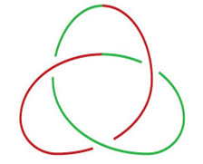
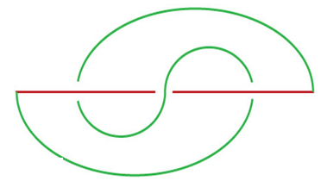

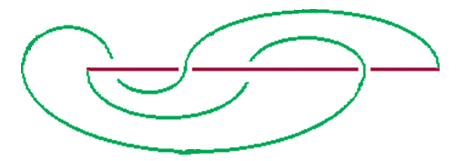
nebismieri Sekruli wiri SegviZlia warmovadginoT
ori araTviTgadamkveTi nawilis gaerTianebis
anu AFL (Arcade_Faden_Lage) saxiT

Slide 3


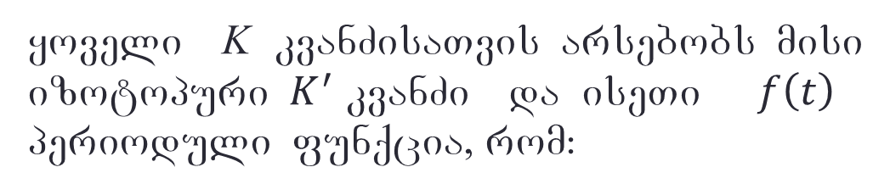

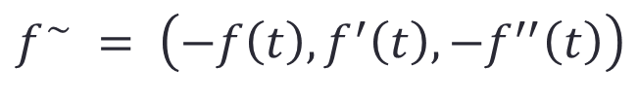
yoveli K kvanZisaTvis arsebobs misi izotopuri $K^{′}$ kvanZi da iseTi $f\left(t\right)$ perioduli funqcia, rom:
$$f:R→R  {C }^{∞}$$
$$S^{1}\text{⊂} R^{3}$$
$$f^{\sim }:S^{1}→R^{3}$$
$$f^{\sim } = \left(−f\left(t\right), f^{′}\left(t\right), −f^{′′}\left(t\right)\right)$$
$$\left(X\left(t\right), Y\left(t\right), Z\left(t\right)\right)=\left(−f\left(t\right), f^{′}\left(t\right), −f^{′′}\left(t\right)\right)$$

Slide 4
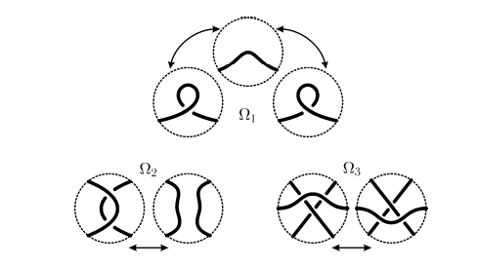
raidemaisteris gardaqmnebi

Slide 5

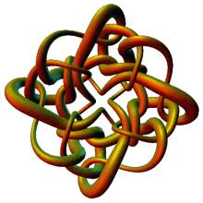
zogadad nebismieri holonomuri saxis wirisTvis maxasiaTebeli funqcia ucnobia
f = ?

Slide 6
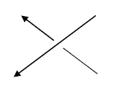
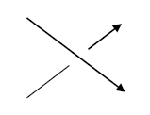
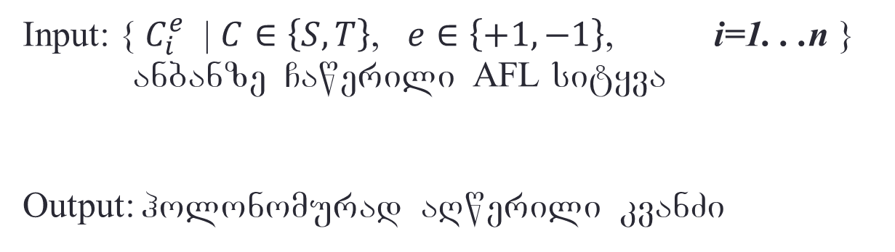
amocanis dasma
Input: { $C_{i}^{e}$ | $C∈\left\{S,T\right\}$, $e∈\left\{+1,−1\right\}$, i=1. . .n } anbanze Cawerili AFL sityva
Output: holonomurad aRwerili kvanZi

Slide 7
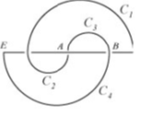
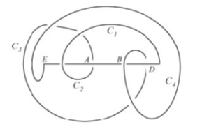

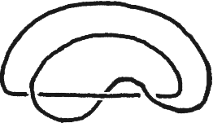
gardaqmnis algoriTmi
gardavqmniT kvanZis Faden nawils
viRebT SesaZlo warmoqmnil zedmet rkalebs
gardavqmniT kvanZis Arcade nawils
vadgenT funqcias da vaxdenT kvanZis parametrizacias

Slide 8
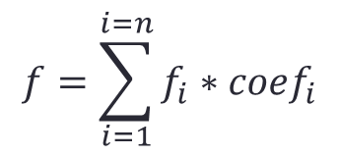
parametrizacia
$\left[0, 2π\right]$ : {$0≤t_{0}<t_{1}<t_{2}<…<t_{i}<…<t_{n−1}<t_{n}≤2π$}
kvanZis TiToeuli i -uri rkali SeiZleba aRiweros f_{i} trigonometriuli funqciebis meSveobiT.
mTeli kvanZi warmoadgens f_{i} funqciebis interpolacias specialuri koeficientebiT, romlebic perioduli, uban-uban mudmivi funqciebia
$$f=\sum_{i=1}^{i=n}{f_{i}∗{coef}_{i}}$$
$f\left(t\right)=f_{i}\left(t\right)$, $f^{′}\left(t\right)=f_{i}^{′}\left(t\right),$ $f^{′′}\left(t\right)=f_{i}^{′′}\left(t\right),$ $∀ i=1..n$

Slide 9
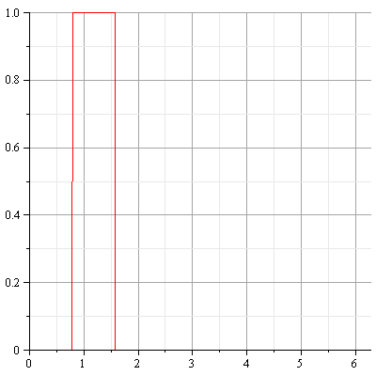



sainterpolacio koeficientebi
$$S_{\left(A, T\right),i}=\frac{1}{2}∗(1+{\left(−1\right)}^{\frac{\left\lfloor t−t_{i−1}\right\rfloor }{T}})∗\frac{1}{2}∗(1+{\left(−1\right)}^{\frac{\left\lfloor t−\left(t_{i}−\frac{T}{2}\right)\right\rfloor }{T}})$$
Notes:
Insert a picture illustrating a custom or tradition here.

Slide 10

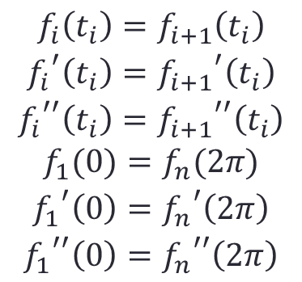
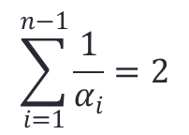
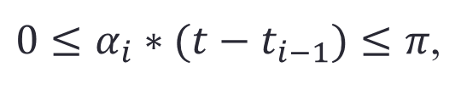


parametrizaciisF $f$ funqciis Tvisebebi
$$f_{i}\left(t\right)=f_{i}\left(α_{i}∗t\right), ∀ i=1..n$$
$0≤α_{i}∗(t−t_{i−1})≤π$,
$$⩝ t∈\left[t_{i−1}, t_{i}\right]$$
$$\sum_{i=1}^{n−1}{\frac{1}{α_{i}}=2}$$
$$α_{i}>0, ∀ i=1..n$$
$$\begin{matrix}f_{i}\left(t_{i}\right)=f_{i+1}\left(t_{i}\right) \\ {f_{i}}^{′}\left(t_{i}\right)={f_{i+1}}^{′}\left(t_{i}\right) \\ {f_{i}}^{′′}\left(t_{i}\right)={f_{i+1}}^{′′}\left(t_{i}\right) \\ f_{1}(0)=f_{n}(2π) \\ {f_{1}}^{′}\left(0\right)={f_{n}}^{′}\left(2π\right) \\ {f_{1}}^{′′}\left(0\right)={f_{n}}^{′′}\left(2π\right)\end{matrix}$$

Slide 11

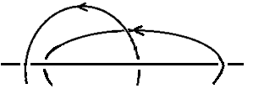
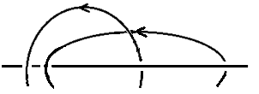
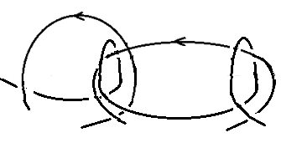
holonomuri da araholonomuri kveTebi


Slide 12
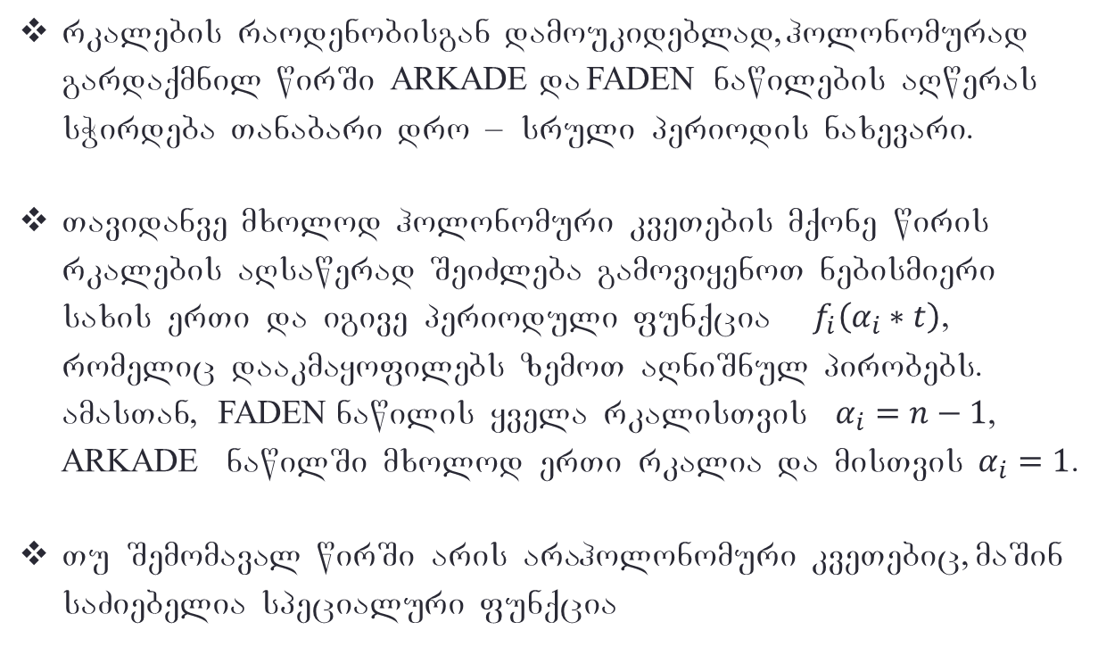
Sedegebi
rkalebis raodenobisgan damoukideblad, holonomurad gardaqmnil wirSi ARKADE da FADEN nawilebis aRweras sWirdeba Tanabari dro – sruli periodis naxevari.
Tavidanve mxolod holonomuri kveTebis mqone wiris rkalebis aRsawerad SeiZleba gamoviyenoT nebismieri saxis erTi da igive perioduli funqcia $f_{i}\left(α_{i}∗t\right)$, romelic daakmayofilebs zemoT aRniSnul pirobebs. amasTan, FADEN nawilis yvela rkalisTvis $α_{i}=n−1$, ARKADE nawilSi mxolod erTi rkalia da misTvis $α_{i}=1$.
Tu Semomaval wirSi aris araholonomuri kveTebic, maSin saZiebelia specialuri funqcia

Slide 13




parametrizaciis funqcia
$$f\left(t\right)=a∗arctg\left(q∗\cos\left(α∗t\right)\right)+b∗\cos\left(α∗t\right)+c$$
sadac:
$q>0$
$a \sim (x0−x1)$
$$b=−a∗q/(1+q^{2})$$
$c=−(x0+x1)/2$

Slide 14
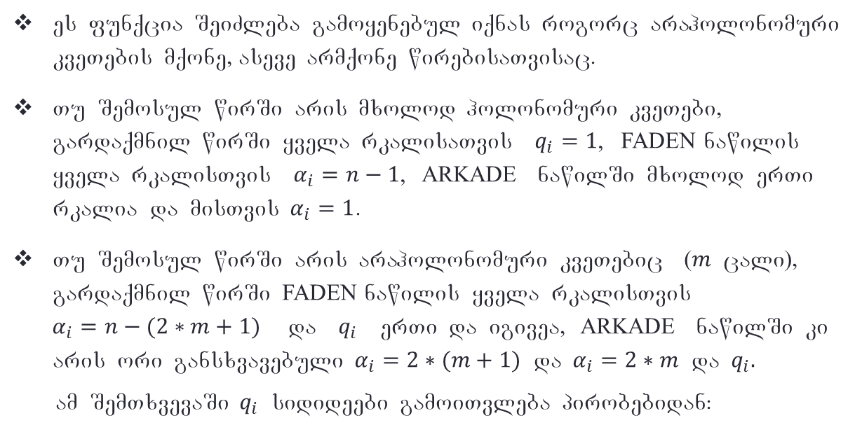

Sedegebi:
es funqcia SeiZleba gamoyenebul iqnas rogorc araholonomuri kveTebis mqone, aseve armqone wirebisaTvisac.
Tu Semosul wirSi aris mxolod holonomuri kveTebi, gardaqmnil wirSi yvela rkalisaTvis $q_{i}=1$, FADEN nawilis yvela rkalisTvis $α_{i}=n−1$, ARKADE nawilSi mxolod erTi rkalia da misTvis $α_{i}=1$.
Tu Semosul wirSi aris araholonomuri kveTebic ($m$ cali), gardaqmnil wirSi FADEN nawilis yvela rkalisTvis $α_{i}=n−(2∗m+1)$ da $q_{i}$ erTi da igivea, ARKADE nawilSi ki aris ori gansxvavebuli $α_{i}=2∗(m+1)$ da $α_{i}=2∗m$ da $q_{i}.$
am SemTxvevaSi $q_{i}$ sidideebi gamoiTvleba pirobebidan:
$$\min_{Faden}\left|{ x}_{k}−x_{k+1}\right|∗qf∗αf>\max_{Arkade}\left|{ x}_{l}−x_{l+1}\right|∗q1∗α1$$
$$\min_{Arkade}\left|{ x}_{l}−x_{l+1}\right|∗q2∗α2<h0$$

Slide 15

marjvena samyura

Slide 16

marcxena samyura

Slide 17

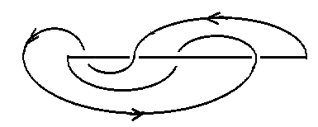
rviani

Slide 18

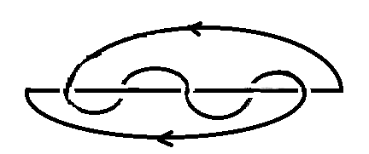
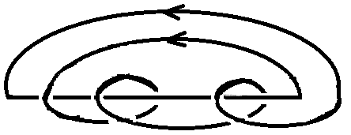
kerZo SemTxveva -
(2,k) saxis toruli kvanZebi
AFL Canaweri $S_{0}^{−1}(T_{i}^{+1}S_{i+1}^{−1})$ i=1..(k-1)/2

Slide 19
gmadlobT yuradRebisTvis!

